Slide 1
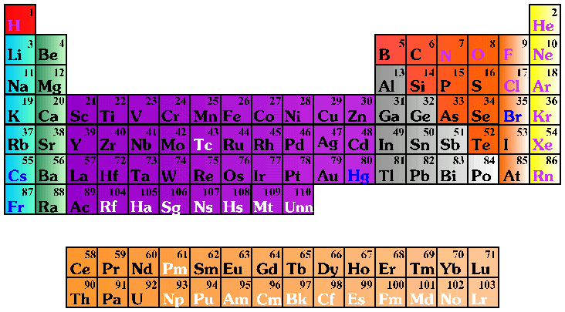
Chapter 3!
Matter and Atomic Structure!

Slide 2
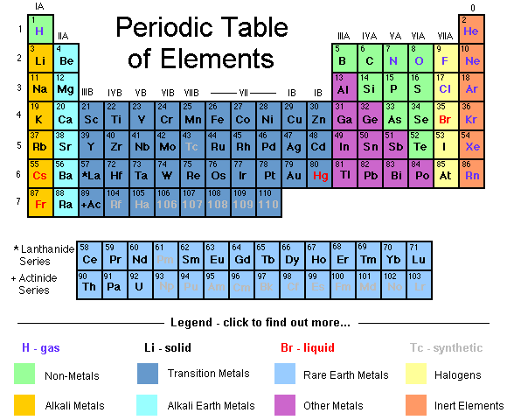
An element is a substance that cannot be broken down into simpler substances.
All matter is made of substances called atoms.
The basic building blocks of matter are atoms.

Slide 3
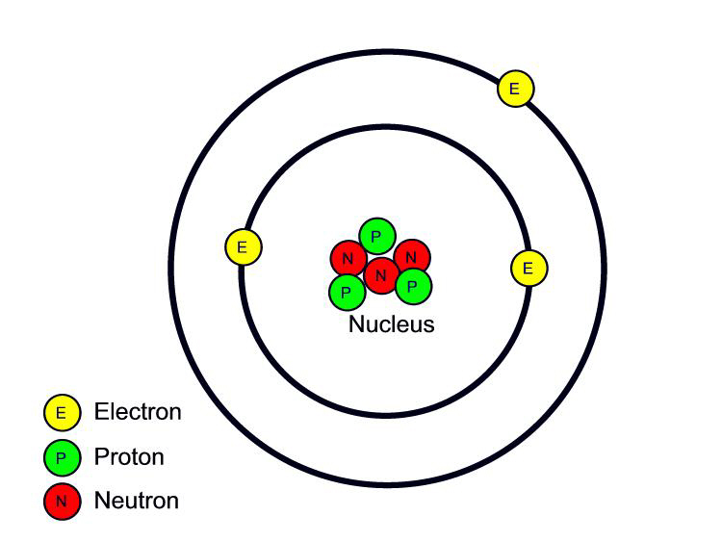
Atoms are made up of protons, neutrons, and electrons. Protons and neutrons are located within the nucleus of an atom. Electrons are found in energy levels surrounding the nucleus.
An atom of Lithium

Slide 4
A tiny particle that has mass and a positive electrical charge is a proton.
An atom of Lithium
The combined number of protons and neutrons is the mass number.

Slide 5
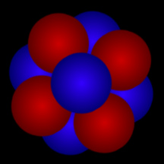
All atomic nuclei have a positive charge because they are made up of neutrons and protons.

Slide 6
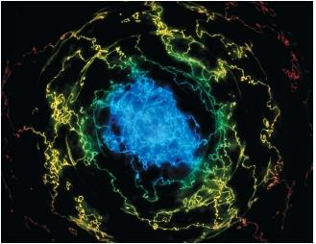
An energy level represents the area in an atom where the electron is most likely to be found.
Electrons tend to occupy the lowest available energy level.

Slide 7
Isotopes are different types of atoms of the same chemical element, each having a different number of neutrons.
All elements are mixtures of isotopes.

Slide 8
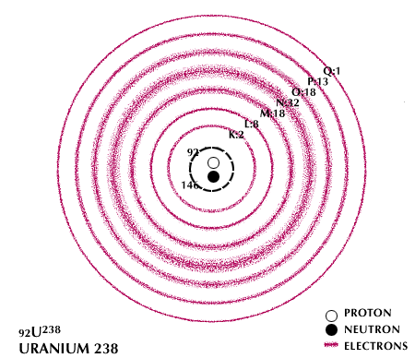
The chemical behavior of different elements is determined by the number of electrons in the outermost energy level (valence electrons).

Slide 9
Elements with the same number of valence electrons have similar chemical properties
.

Slide 10
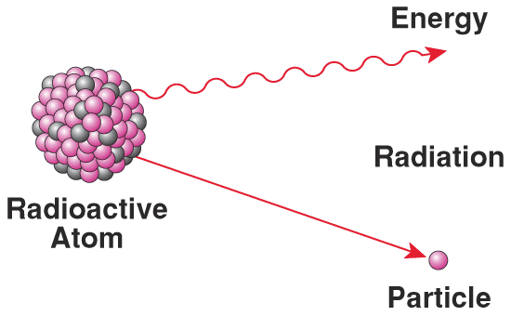
Radioactive Decay
During radioactive decay, a nucleus can gain or lose protons and neutrons.

Slide 11
Half-Life
Half-life refers to the time it takes for approximately half of radioactive material to decay to a lighter more stable nuclei. The materials we refer to are unstable radioactive elements.

Slide 12
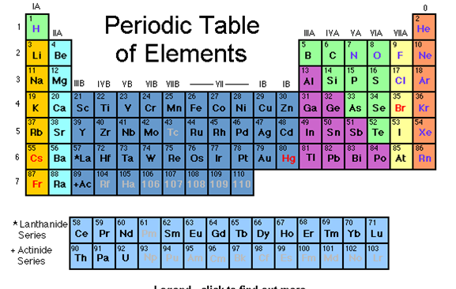
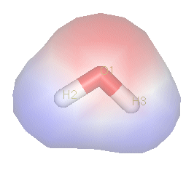

Molecules versus Atoms
Both are terms used to describe the particles that make up the universe.
Atom - the smallest particle of a chemical element
Molecule - a group of atoms chemically bonded together
the smallest fundamental unit of a compound
Water
H₂O
Nitrogen
N₂

Slide 13
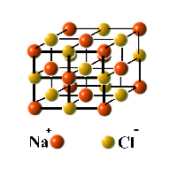
Most compounds have different properties from the elements of which they are composed.
Common Table Salt
NaCl
Water
H₂O

Slide 14
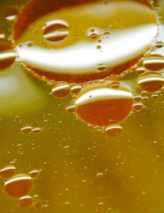
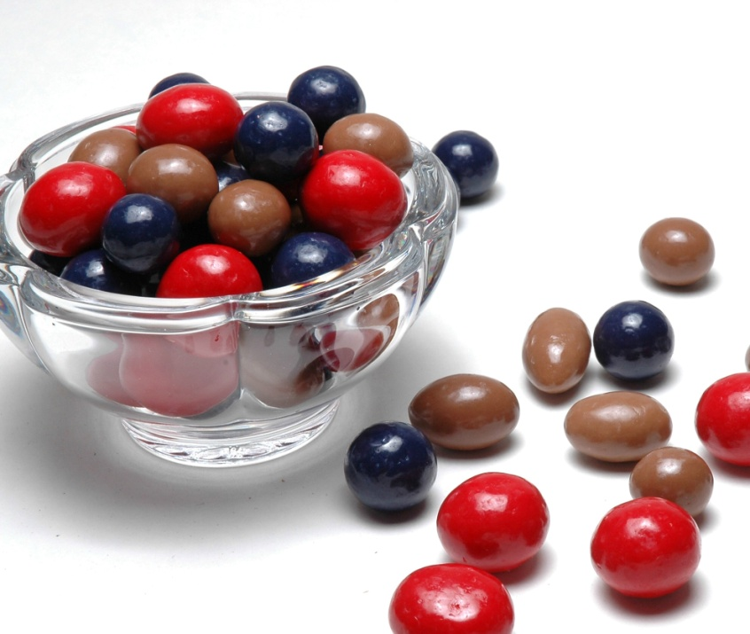
A combination of two or more components that retain their identity is a mixture.

Slide 15
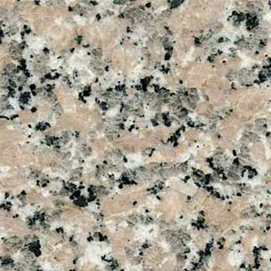
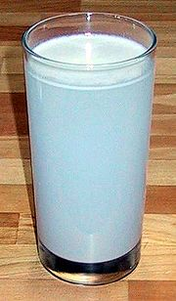
Granite is an example of a heterogeneous mixture.

Slide 16
In a heterogeneous mixture the components are still recognizable.

Slide 17
In a homogeneous mixture, also called a solution, the component particles cannot be distinguished

Slide 18
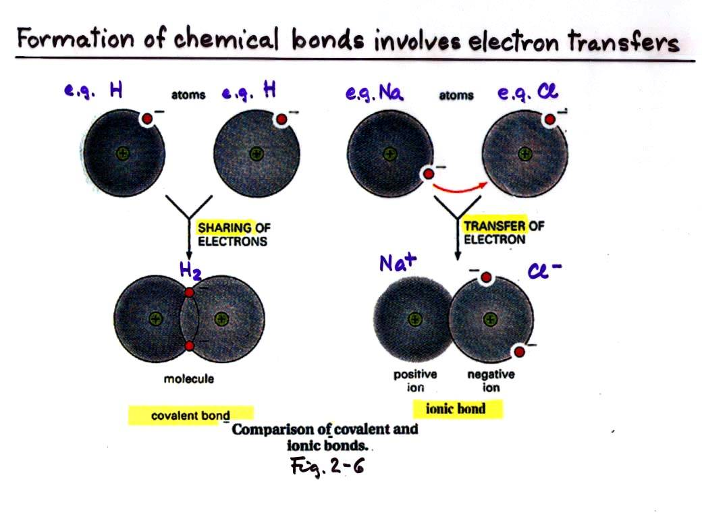
Bonds
Ionic
Transfer of electrons
Covalent
Sharing of electrons

Slide 19
A covalent bond is the attraction of two atoms for a shared pair of electrons that hold the atom together.
When atoms in a covalent bond do not share electrons equally, they form a polar molecule.
Water
H₂O

Slide 20
A molecule of chlorine gas is made up of pairs of chlorine atoms in which each atom shares one of its seven electrons to form a covalent bond.
Cl Cl

Slide 21
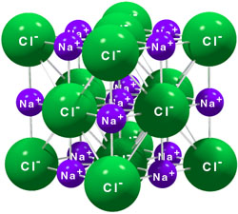
When Na⁺ and Cl⁻ combine to form NaCl, this is an example of an ionic bond.

Slide 22
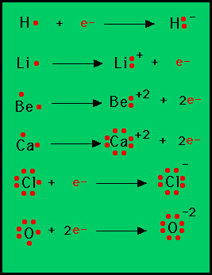
An atom that gains or loses an electron is a charged particle called an ion.
An atom in which the outermost energy level is more than half full tends to form negative ions.

Slide 23
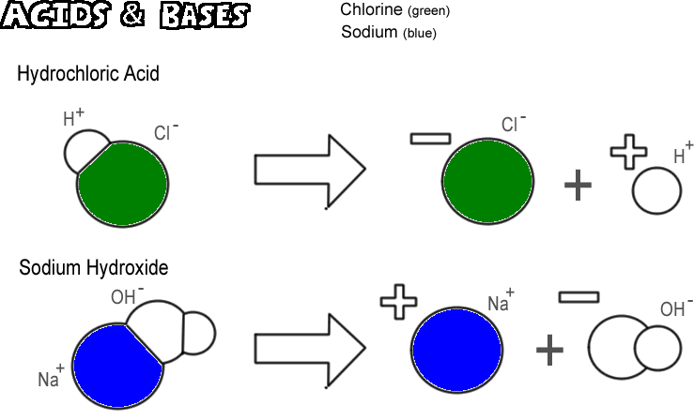
Solutions containing a substance that produces hydrogen ions (H⁺) in water are acids.
Solutions characterized by the formation of hydroxide ions (OH⁻) are bases.

Slide 24
H⁺(aq) + OH⁻(aq) → H₂O(l)
A base can neutralize an acid by combining with hydrogen ions of the acid to form water.

Slide 25
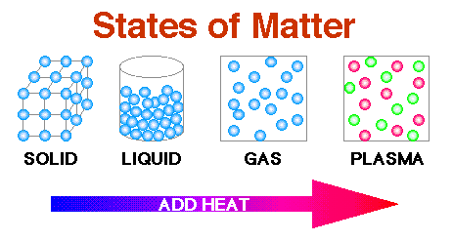
States of Matter
Matter exists in four states in the universe.

Slide 26
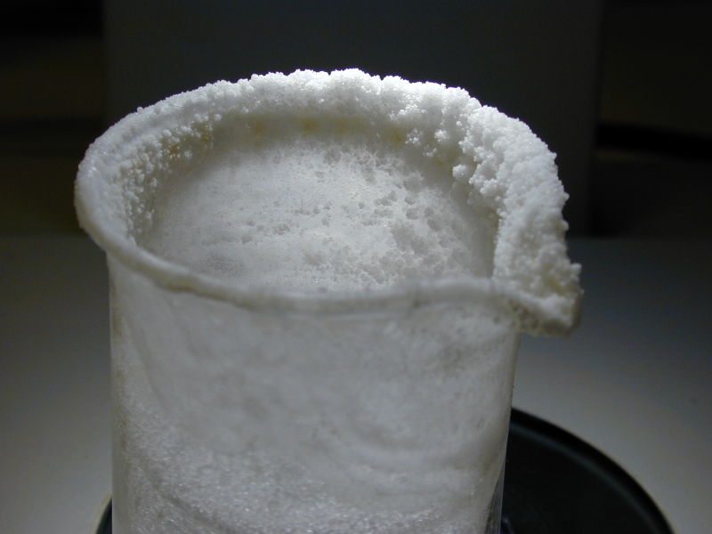
Solid
Most solids have a crystalline structure
Example: Table salt is a solid with a crystalline structure.

Slide 27
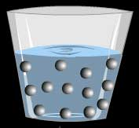
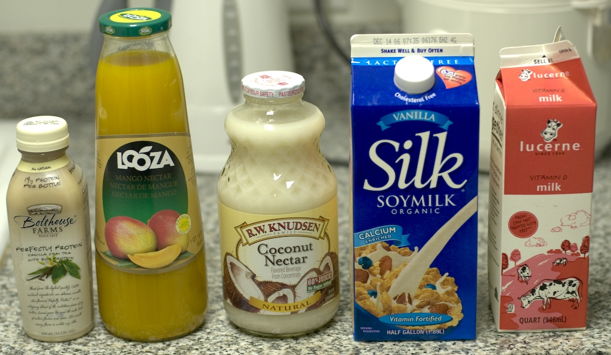
Liquid
Densely packed, ever-changing arrangements of atoms and molecules are liquids.

Slide 28
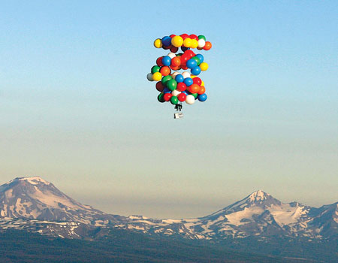
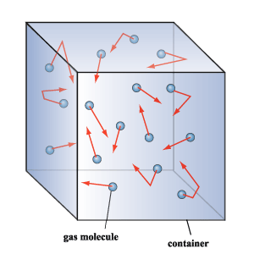
Gas
Atoms or molecules always occupy the whole of the space in which they are contained.

Slide 29
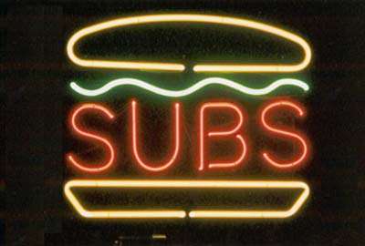
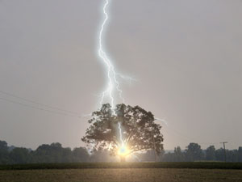

Plasma is extremely hot, highly ionized, electrically conducting gases
Lightning
Neon Signs
The corona around the Sun is formed from plasma.

Slide 30
STATE CHANGES
From a solid to a liquid – melting
From a liquid to a solid – freezing
From a liquid to a gas – evaporation
From a gas to a liquid – condensation
From a gas to a solid – deposition
From a solid to a gas - sublimation

Slide 31
Conservation of energy – Matter can be changed from one form to another but cannot be created or destroyed.

